Slide 1

아름다운코딩 with 프로세싱.py
Processing in Pycharm

Slide 2
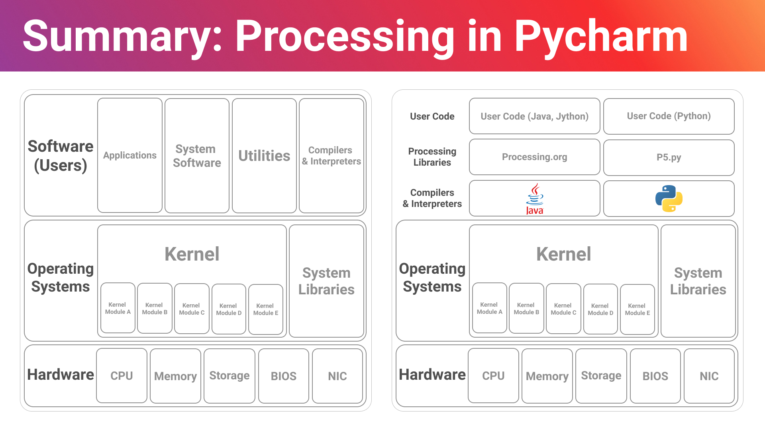

Slide 3
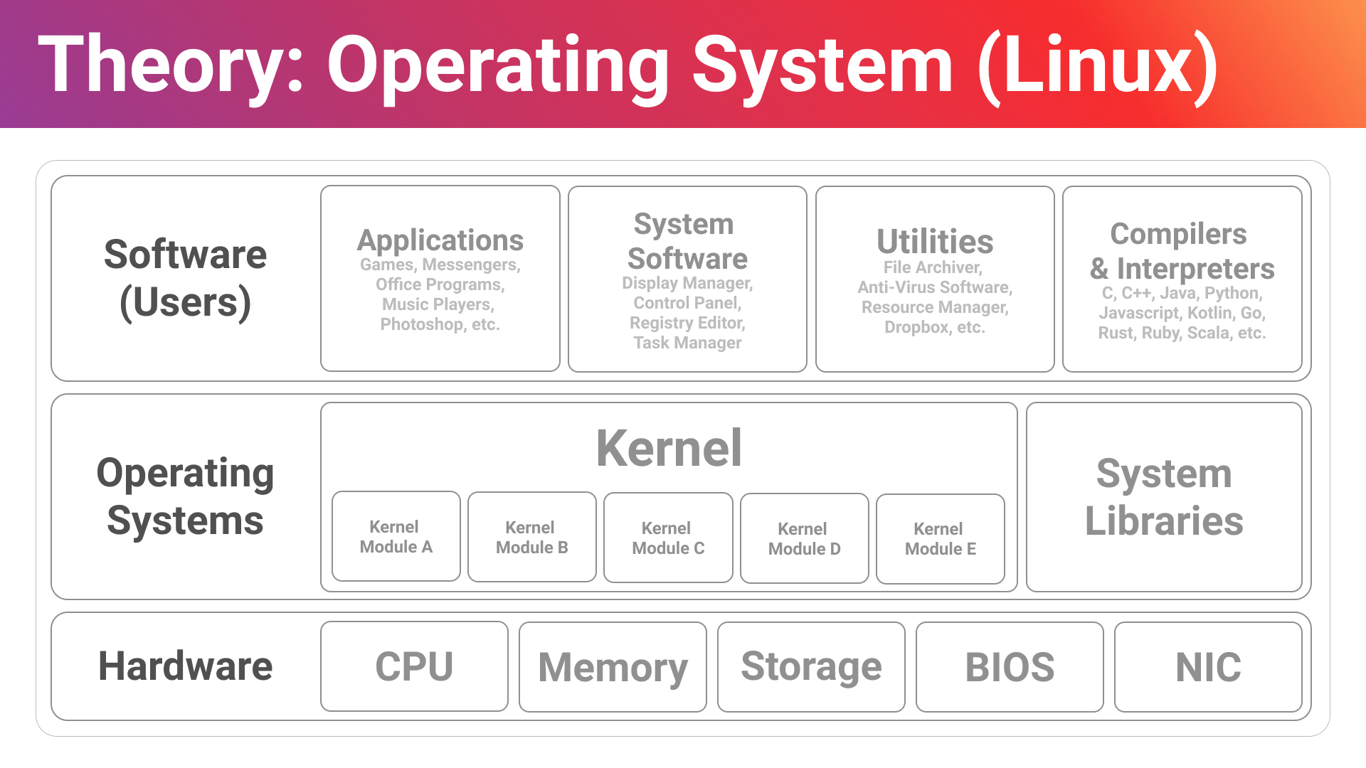

Slide 4
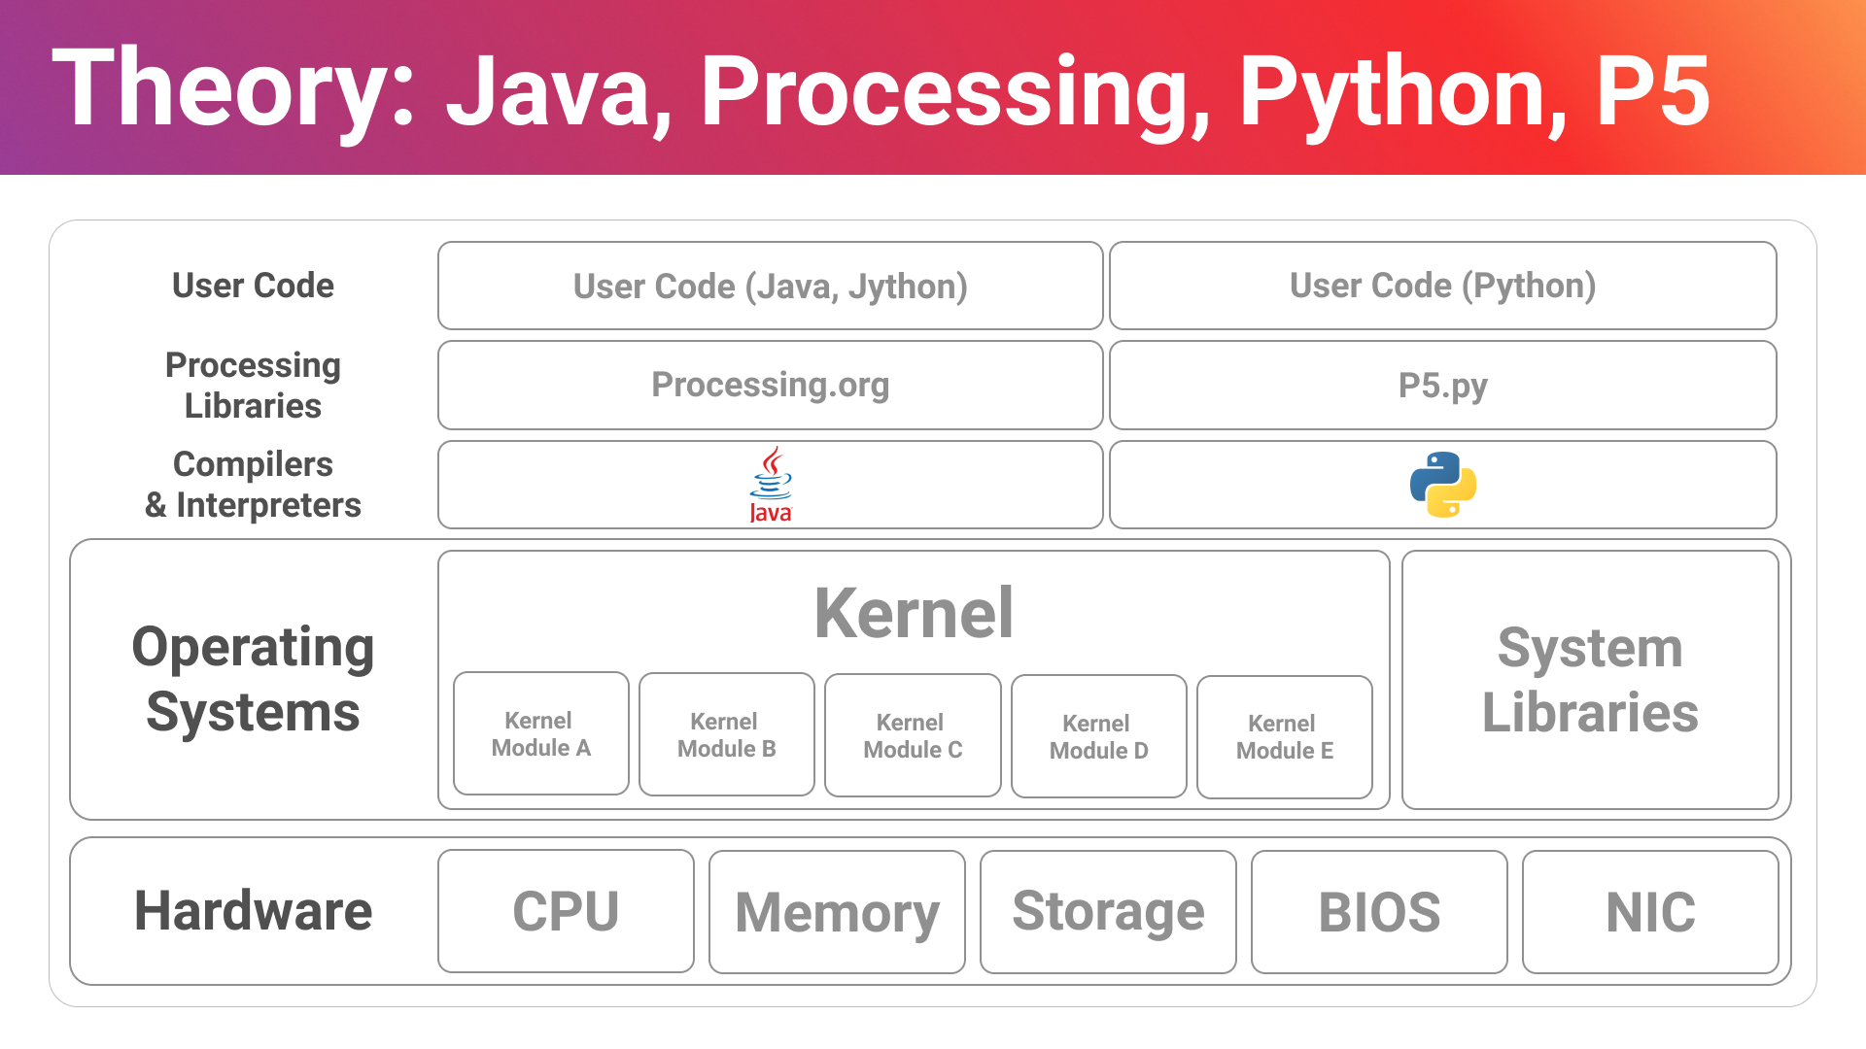

Slide 5
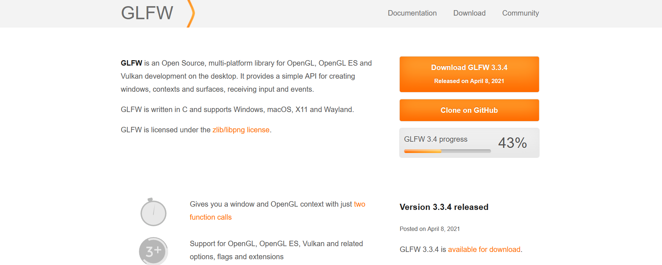
Prerequisite: GLFW Graphics Library
참고문헌: https://www.glfw.org/

Slide 6
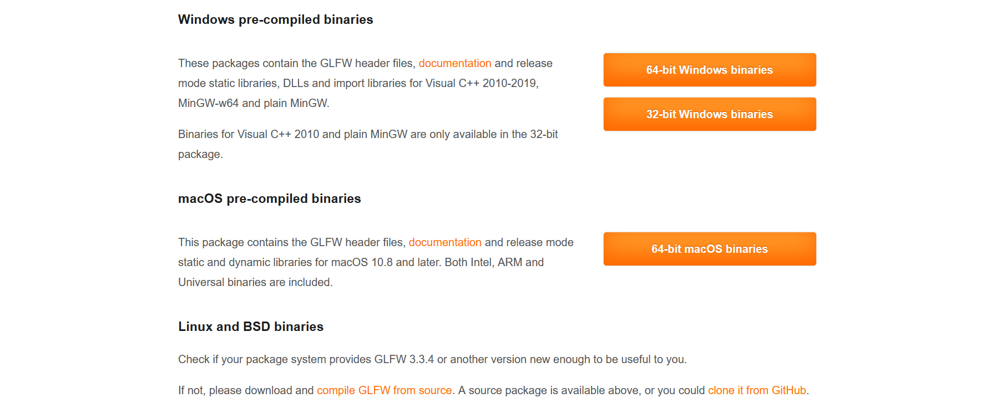
GLFW Installation
참고문헌: https://www.glfw.org/download.html

Slide 7
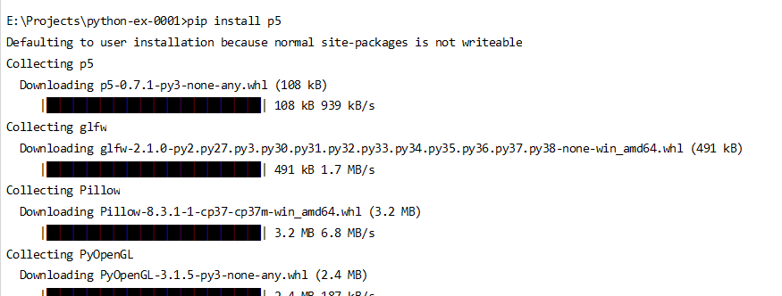
P5 (Processing Python Library)
E:\> pip install p5
참고문헌: https://pypi.org/project/p5/

Slide 8
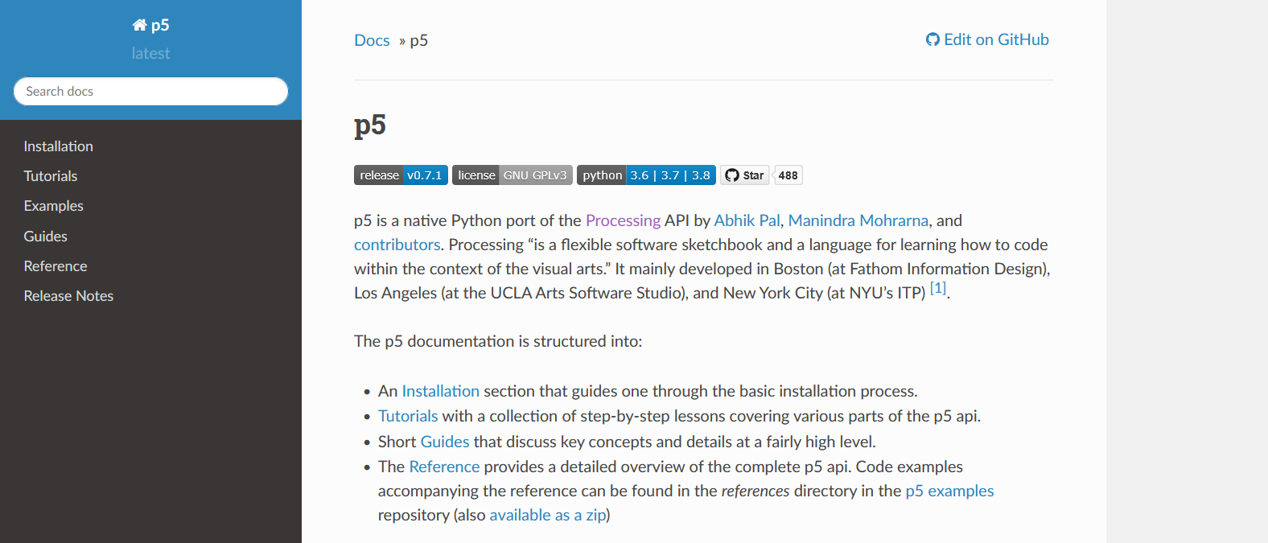
P5 Documentation
https://p5.readthedocs.io/en/latest/index.html
참고문헌: https://p5.readthedocs.io/en/latest/index.html

Slide 9
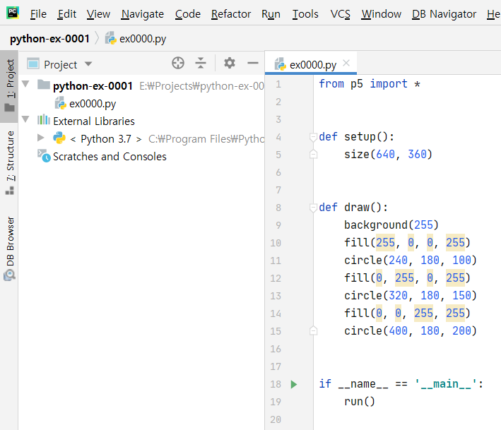
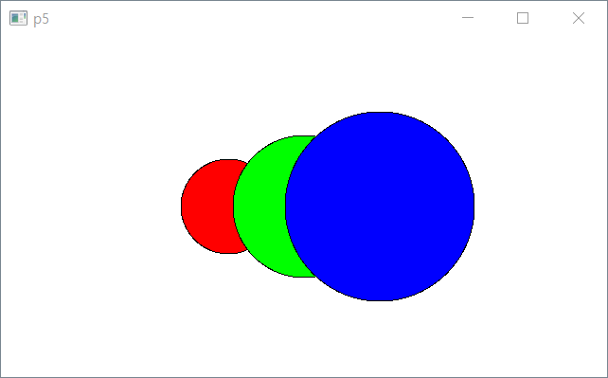
P5 Execution Format
from p5 import *; if __name__ == ‘__main__’: run()
참고문헌: https://p5.readthedocs.io/en/latest/tutorials/color.html

